Slide 1
Parent Training
Notes:
Introduce yourself.

Slide 2
Learning Intentions
The learner will be able to:
Navigate within the Schoology platform as a parent using web or mobile app
Customize their settings and notifications
Use Schoology features to monitor student learning progress
Notes:
Time: 2 minutes
Materials:
Strategy:
Presenter Notes:
Allow participants a minute to read the learning intentions.

Slide 3
Success Criteria
I can:
Customize my Schoology Account settings based on my preferences
Access my child's courses within Schoology on web or mobile app
Identify content in the Parent Folder within my child's courses
Notes:
Time: 1 minute
Materials:
Strategy:
Presenter Notes:
Allow participants a minute to read the success criteria.

Slide 4
Greetings families and loved ones! I sent an email through Schoology just testing it out. As we, all become more familiar I will begin sending emails through Schoology. You can access our Newsletter as well as so much more.
Please click the link below to view how to log in to Schoology for the 1st time.
https://www.fortbendisd.com/domain/13864
Notes:
Time: 4 minutes
Materials: Video
Strategy:
Presenter Notes:
Say: In early 2018, 9 campuses participated in a parent access pilot in Schoology. This access allowed for them to have their own account to view their student's online learning experiences and activity. Parents were able to view any assignments, discussions, completed assessments, calendar updates, or content that was shared by their child's teachers. There is also the capability to message teachers directly in Schoology. This year, all parents in FBISD will have opportunities to use Schoology.
Say: We are excited to have you become a part of the Fort Bend ISD Schoology family. Schoology offers teachers and students multiple avenues for collaboration, communication, assessment, submitting assignments and participating in discussion boards. In this upcoming video, we will learn more about Schoology and take a look at the benefits it offers to students at Fort Bend ISD.

Slide 5
Notes:
Time: 4 minutes
Materials: Video
Strategy:
Presenter Notes:
Say: In early 2018, 9 campuses participated in a parent access pilot in Schoology. This access allowed for them to have their own account to view their student's online learning experiences and activity. Parents were able to view any assignments, discussions, completed assessments, calendar updates, or content that was shared by their child's teachers. There is also the capability to message teachers directly in Schoology. This year, all parents in FBISD will have opportunities to use Schoology.
Say: We are excited to have you become a part of the Fort Bend ISD Schoology family. Schoology offers teachers and students multiple avenues for collaboration, communication, assessment, submitting assignments and participating in discussion boards. In this upcoming video, we will learn more about Schoology and take a look at the benefits it offers to students at Fort Bend ISD.

Slide 6
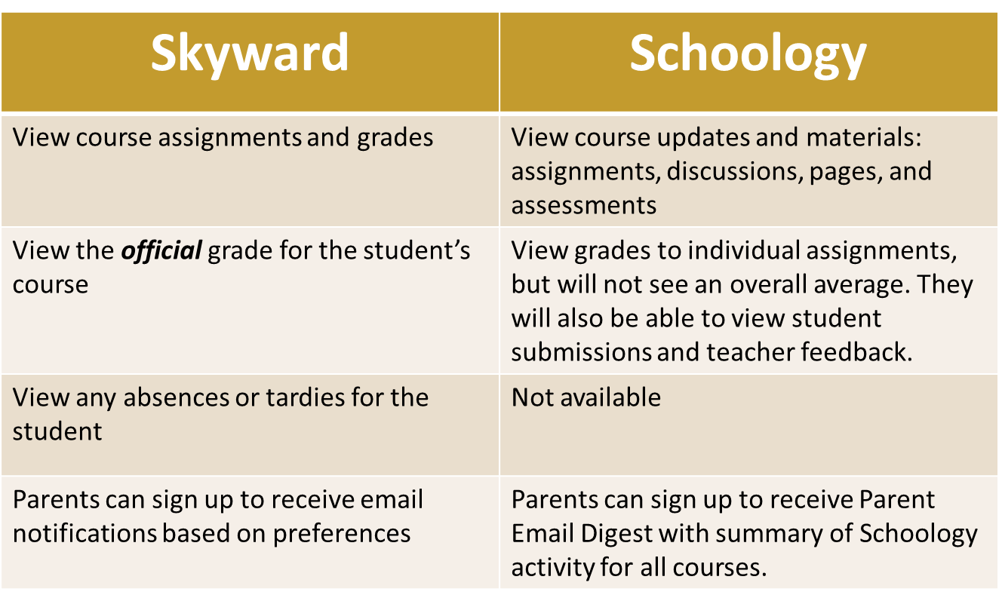
Notes:
Time: 3 minutes
Materials:
Strategy:
Presenter Notes:
In Skyward Family Access, you are able to…
View course assignment titles and grades
View the official grade for your student in the course
View any absences or tardies for your student
Sign up to receive email notifications based on your preferences
With parent access in Schoology, you will be able to…
View all of your child’s courses and
View your child’s Schoology/online assignments, discussions (other student names will appear as anonymous), and quizzes, along with any associated Schoology grades
View school/class announcements and events
Send and receive messages from the teacher
Next, we'll look at a 3rd grading category.

Slide 7
Formative Assessment
FBISD Assessment Philosophy
FBISD believes in empowering and growing all learners by utilizing fluid feedback and reflective practice to determine where students and educators are and where they are going in the teaching and learning process.
Notes:
Time: 2 minutes
Materials:
Strategy:
Presenter Notes:
Say: FBISD believes in empowering and growing all learners by utilizing fluid feedback and reflective practice to determine where students and educators are and where they are going in the teaching and learning process. Previously, the district had two grading categories; Daily and Major. Each counted for 50% of the students' grade. This year, the district is adding Formative Assessment as a category. This category will not have a percentage associated with it and it will not count towards the students' grade. The purpose of formative assessment is to help teachers identify concepts that students are struggling to understand, skills they are having difficulty acquiring, or learning objectives they have not yet achieved so that adjustments can be made to lessons, instructional techniques, and academic supports.
Now that we've gone over the differences between Skyward and Schoology and have an understanding of Formative Assessment, let's look at how you can access schoology nad set up your account.

Slide 8
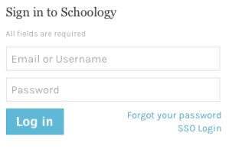
Accessing Schoology and Setting Up Your Account for the First Time
Notes:
Time: 10 minutes
Materials: Schoology-Parent How To Change Password Job Aid
Strategy:
Presenter Notes:
Say: The procedure for setting up your Schoology account has you navigating through the "forgot password" process. Since the account is drawn from your Skyward Family Access information, using the "forgot password" option is the quickest and most efficient means for parents to access their username, password and account. In addition, if you have students at multiple schools within Fort Bend ISD you will see each child within your Schoology account.
Note to TIC: If you are not a parent in the district, you will not be able to model the below steps. You will need to ask a parent to volunteer to follow the below steps on your presentation screen to model the steps for all participants.
(Demonstrate as you go through each step)
1: Navigate to www.fortbendisd.com.
2. Click on Parents and Students.
3. Click on Schoology-Parent Login.
4. Click on Login to Parent Schoology.
5: Click on the Forgot Your Password link.
6: Type in the email that was used to register for Skyward Family Access.
7: Click on Send My Login Info.
8: If you used the correct email address, you’ll receive a message that states: 'Further instructions have been sent to your email address'. If you used an incorrect email address, you’ll receive a message that states: 'The email address you entered does not belong to any account'.
9: If you entered the correct email address, you will receive 2 emails: 1 from notifications@schoology.com and 1 from no-reply@schoology.com. Go ahead and check your email at this time. You will want to check your spam folder in case the emails were sent there. (Give them a moment to check email AND WALK AROUND TO PROVIDE ASSISTANCE)
10: Click on the Log In link in the email you received. This will allow you to reset your password and receive your username.
11: The password reset screen will show your username that can also be used to sign into Schoology. We recommend using the email address you previously used. Type in your new password and click Submit. You should receive confirmation at the top of the page that your password has been changed.
12: Click the dropdown by your name to see your linked children.
10: You can also download the Schoology app from the Apple and Android store but you must first set up your account through the browser before using the Schoology app.
Job Aid: https://www.fortbendisd.com/cms/lib/TX01917858/Centricity/domain/74/1.%20teaching%20and%20learning/schoology%20webpage/Schoology%20-%20Parent%20How%20to%20Change%20Password.pdf

Slide 9
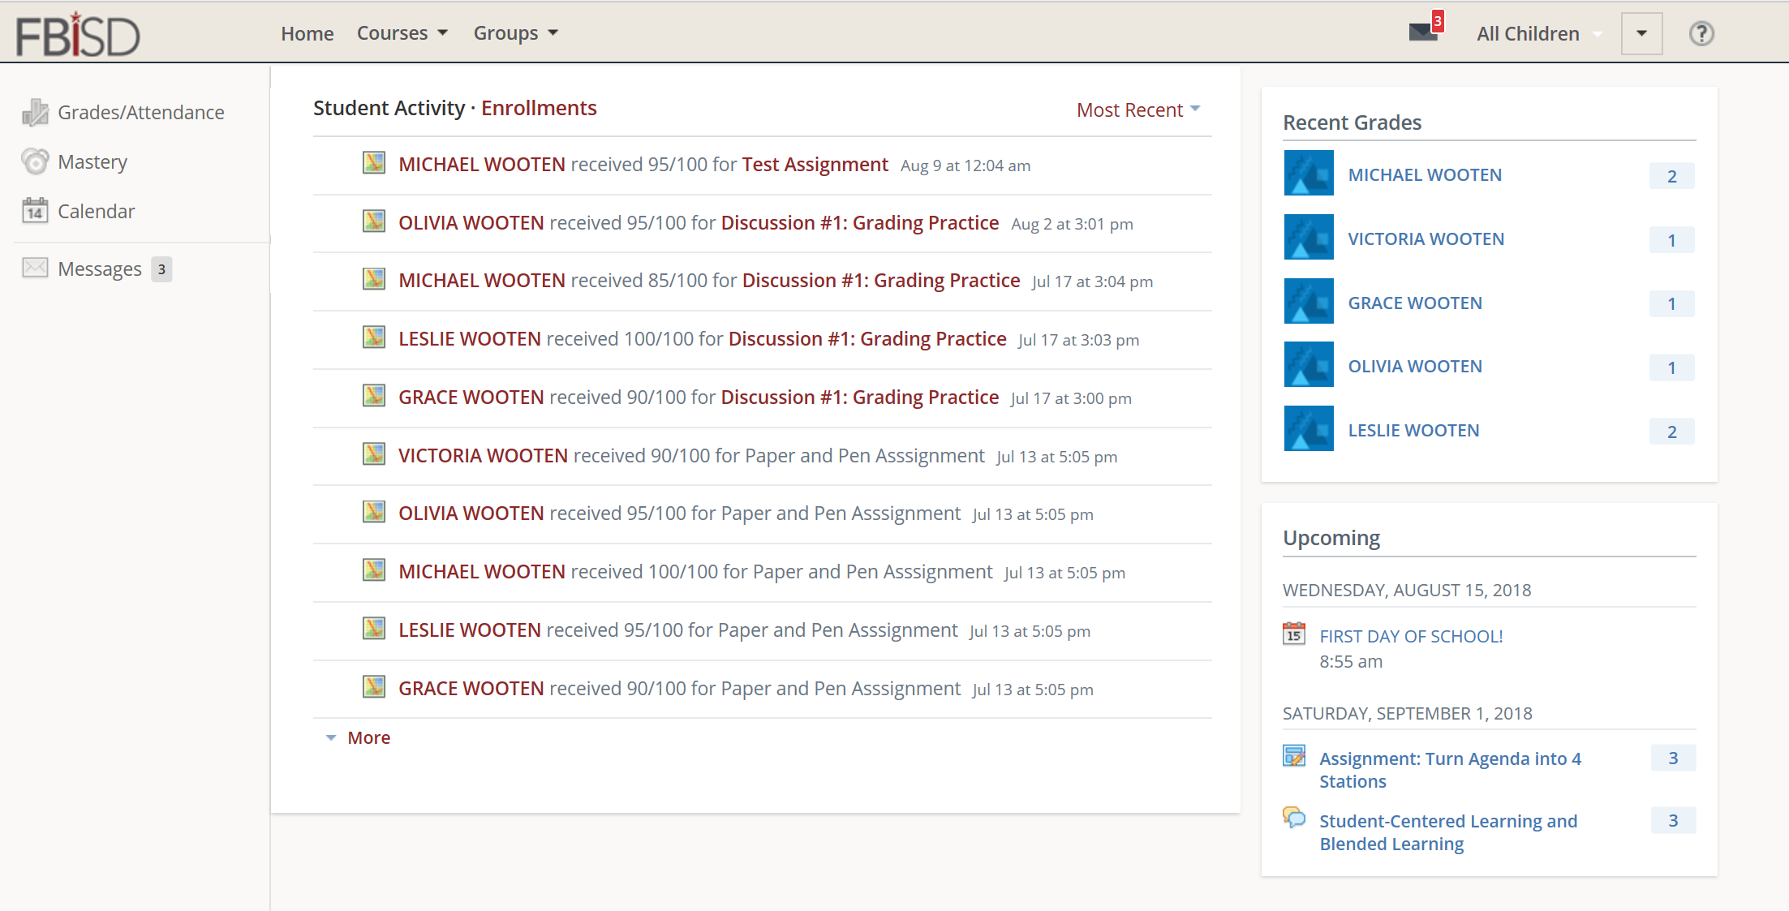
Customizing your Schoology Account
Notes:
Time: 5 minutes
Materials:
Strategy:
Presenter Notes:
Say and Demonstrate: This is the landing page for your child’s Schoology account. In the left column you can view your child’s grades, mastery, calendar, and messages sent and received by a teacher. In the middle, you will see the courses and groups your child is a part of or you can choose to see it by student activity. To switch views, click on Enrollment to see the courses and groups your child is a part of and click on Student Activity to see children’s activity. To the right, you will see recent grades, any overdue assignments, and upcoming assignments.
Say and Demonstrate: You also have the ability to set up notifications. To set up notifications, you will go to the dropdown in the top right corner and select notifications. There are 2 types of notifications you may choose to have. The 1st is an email digest of your child’s activity within Schoology. Select 'On', select if you want it daily or weekly', select the 'time' you’d like to receive the email, and if you selected weekly, select the 'day' you’d like to receive the report. If you choose daily, you will select the time. You may also set up to receive overdue submission emails. This will send an email if an assignment was given and it was not turned in on time or is late. After making your selections, click Save Changes.

Slide 10
Notes:
Time: 2 minutes
Materials: Parent Email Digest PDF
Strategy:
Presenter Notes:
Say: Here is an example of an email digest. It shows overdue assignments and also activity within Schoology for the week. Just a reminder that Skyward is the official record of grades and assignments. Any grades that are shown are ones from within Schoology but does not reflect the student’s overall grade. That is calculated in Skyward.
Do: Hand out Parent Email Digest PDF
https://support.schoology.com/hc/en-us/article_attachments/201452377/parent_email_overdue.png

Slide 11
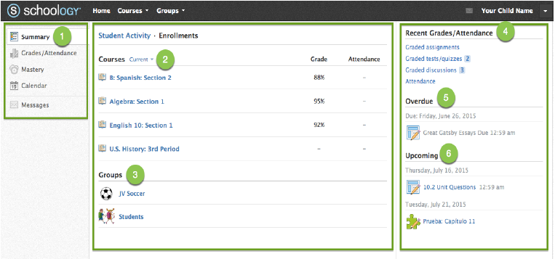
Navigating Schoology
Notes:
Time: 10 minutes
Materials: Navigating Within Schoology PDF
Strategy:
Presenter Notes:
Say: Here we will walk through the different views and information you can see from within your child’s Schoology account.
Say and Demonstrate: When you log into Schoology, you will see the home page. Across the top are Home, Courses, and Groups. These tabs stay on every page in Schoology. To the right is your name and a drop down for setting up notifications and also for switching between children if you have more than one child within the district. To view another child's account, simply click on the arrow next to your name in the upper-right corner and choose the child you'd like to view.
Say and Demonstrate: Let’s talk about the main homepage. It is divided into 3 sections. On the far left is the quick menu bar. Here you will have a summary that shows you your child’s classes and any groups they are a part of. There is a tab for grades and attendance, but remember, Skyward is the official record for all grades and attendance so the only data you would see here are assignments done within Schoology. There is also a calendar, which lets you see assignments and due dates that are posted for your child for Schoology related assignments. You’ll also see messages. This is where any messages you’ve sent or received will show here. In the middle is the enrollment for your child. This lists all the courses that your child is currently taking. You’ll also see any groups that they are a part of. This could be for a sport or club they are a part of. On the far right is a section for recent grades. Again, Skyward is the official record of all grades but anything done within Schoology such as an assignment, a test or quiz, or a discussion that might have been graded will be here. Beneath it is upcoming. This will show upcoming assignment or events that the teacher may have assigned.
Let’s click on a course. When you click on a course, it will take you to that child’s course. You will see very similar information on the left: materials, updates, grades, and members, but you only get access to your child’s work. Materials that might be posted such as discussions, you’ll see your child’s discussion and his participation in that discussion only. For an assignment, you’ll be able to see what they posted. If you would like to go back to the home page, click on Home, or if you want to navigate to another course, click on Courses and select a new course you’d like to view.

Slide 12
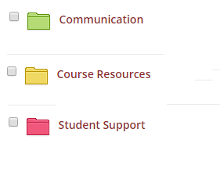
Parent Folder
Notes:
Time: 3 minutes
Materials:
Strategy:
Presenter Notes:
Say: When a parent logs into Schoology, they will notice each teacher has a folder called "Parent Folder." Within this folder are three sub folders that offer a variety of supports. The first folder is labeled “Communication” – This folder is where you will find items such as Parent Newsletters, permission slips, or any other general communication that the teacher chooses to share with parents. Some teachers have even included a media album with pictures of what is going on in their classroom. The next folder is called “Course Resources.” This folder is where teachers will share general classroom information. Examples might include rules, procedures, course syllabus, calendars, online textbook login information, and school online login information. The final folder is labeled “Student Supports.” This folder could include teacher posted resources such as helpful websites regarding a concept along with videos and documents that parents can use to help their child be successful in the class.

Slide 13
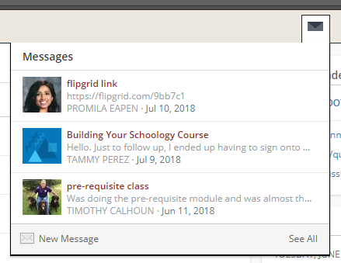
Messages
Notes:
Time: 3 minutes
Materials:
Strategy:
Presenter Notes:
Say and Demonstrate: Checking for New Messages:
When you have a new message in your inbox, the Messages icon on the top menu displays a new number.
Navigate to your Messages area by clicking on the icon in the top menu.
New messages are indicated with red number. Click the message you'd like to read.
To reply to a message, write in the Message area, then click Send.
Checking for Sent Messages:
Navigate to your Messages area by clicking the icon in the top menu and clicking See All.
Click the Sent Messages tab.
To read a message, click a message you've sent in the past.
Sending a Message:
1. To send a message, click the New Message button.
2. Fill out the form, and click Send to complete.
A recipient name automatically populates when you enter a teacher's name into the To field. If you're not able to send a message to certain users, talk to the teacher for further guidance.

Slide 14
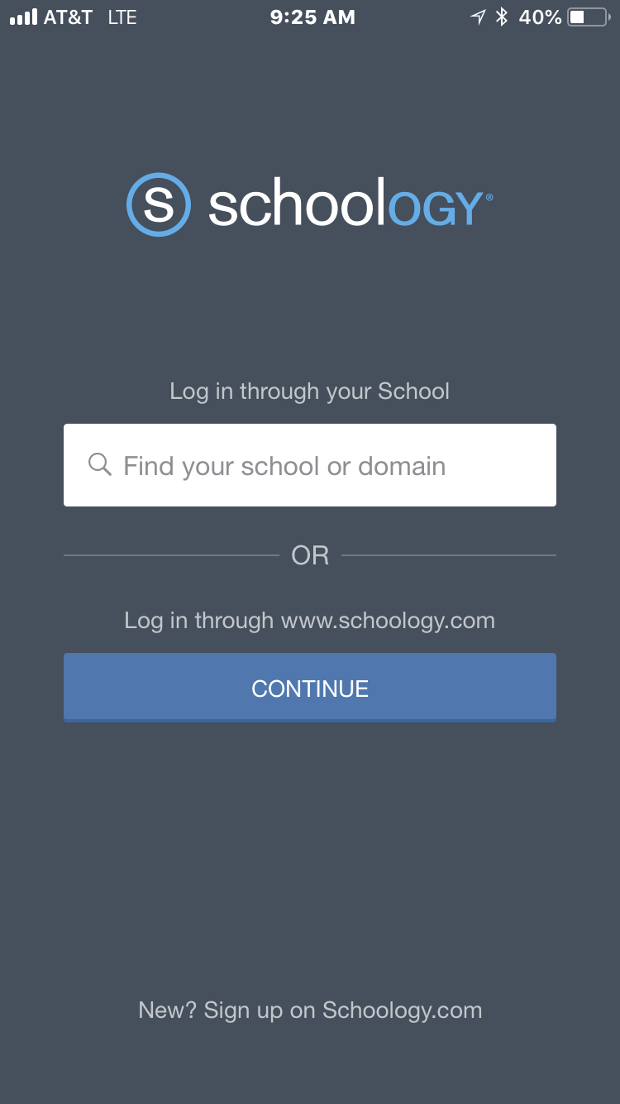
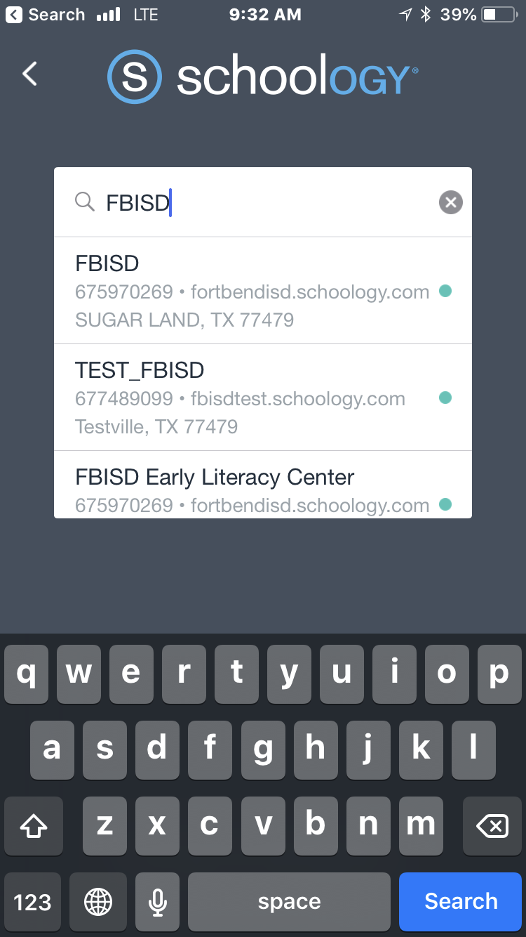
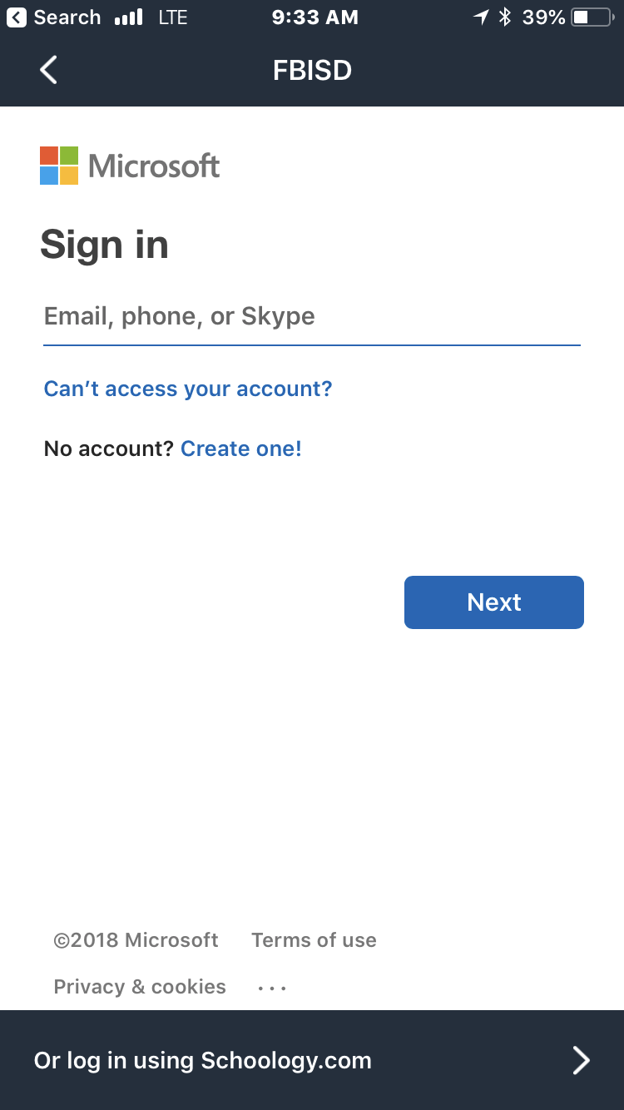
Accessing Schoology Through the Mobile App
Notes:
Time: 4 minutes
Materials:
Strategy:
Presenter Notes:
Say: Schoology can also be accessed through the mobile app. Let’s take a few minutes to download the app and set up our account.
First, go to your app store on your mobile device and search Schoology. Then download the app.
Launch the app and you will see a screen asking you to select a school or district.
In the search box, type in FBISD in ALL CAPS. (Typing in the school or Fort Bend ISD will not bring up the district.)
Choose the first selection that says FBISD. It will show fortbendisd.Schoology.com with Sugar Land, TX 77479 under the name.
Next you’ll see a Microsoft sign in. You will ignore this sign in page and instead, at the bottom of the screen, click on “Or log in using Schoology.com”
Input the email address you currently use to log in to Skyward as well as the password and then click “Log In”.

Slide 15
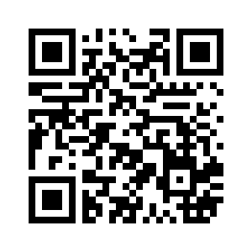
SCHOOLOGY PARENT SUPPORT
Support Hours and Contact Information:
Hours: Mon-Fri 6:30AM - 6:00PM
Phone: 281-634-1300
Email: csc@fortbendisd.com
After hours, please feel free to submit an email to the Customer Service Center. Be sure to include contact information and that you are requesting support with Schoology and Parent Access.
Notes:
Time: 1 minute
Materials:
Strategy:
Presenter Notes:
Share information on slide and explain they can scan the QR Code to view the Parent Support webpage for Schoology.

Slide 16
Notes:
Time: 2 minutes
Materials:
Strategy:
Presenter Notes:
Say: Setting up notifications and learning how to navigate within the platform will make your experience with Schoology much better. We encourage you to sit down with your child and have them share features used in their class so you will better understand how Schoology is a part of your child's learning.

